Slide 1



Prepared by 4th batch.
08 Jul 2023

Slide 2

Overview: As per the data 39,717 number of items .We are using different types of categories to analyze the data and find out the verified and non-verified customer based on year and interest. How payment mode in effected in loan section.
State wise analysis the data and grade v/s balance.
Methodology:
The Research conducted a quantitative analysis on data and data set gotten from EXCELR.

Slide 3

Tools:
While explaining Bank loan of customer data analysis, we use below 4 tools.
1.Excel
2.SQL.
3. Tableau
4.Powerbi.

Slide 4

Analysis: We analyze the data depending on the below 5 categories. 1. Year wise loan amount Stats 2.Grade and sub grade wise revol_bal 3.Total Payment for Verified Status Vs Total Payment for Non-Verified Status 4.State wise and month wise loan status 5.Home ownership Vs last payment date stats

Slide 5




Introduction of data:
Total number of loan accounts 39,717
Total loan amount
$445,602,650.00
Loan Tenure
36 and 60 months
Avg Interest rate
12.02%
Grades
A,B,C,D,E,F and G

Slide 6


Year wise loan amount Stats
We observe that 2011 have highest amount and 2007 have lowest amount.
EXCEL

Slide 7
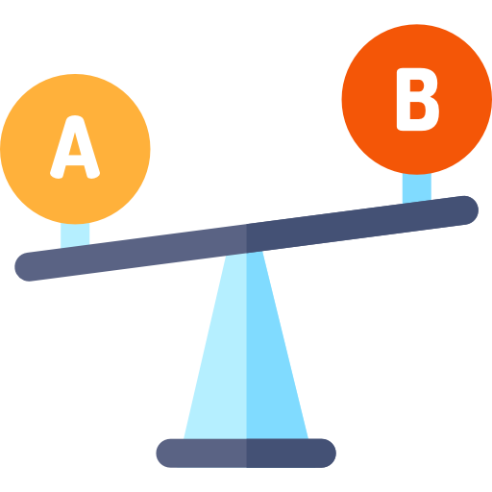
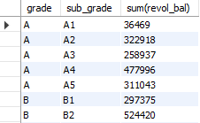
SELECT grade,sub_grade,sum(revol_bal) from financegroup by grade,sub_grade having sum(revol_bal)order by grade;
Grade and sub grade wise revol_bal
Grade A balance are good compared to other grades. We need to take actions on G grade.
SQL

Slide 8
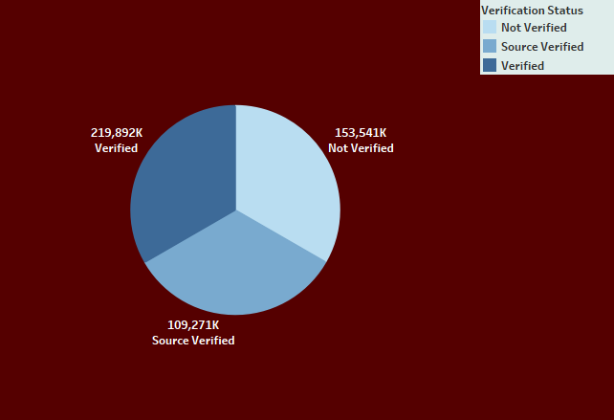

Total Payment for Verified Status Vs Total Payment for Non-Verified Status
We need take an action on not verified accounts. Because these account going forward will create loss.
Tableau

Slide 9
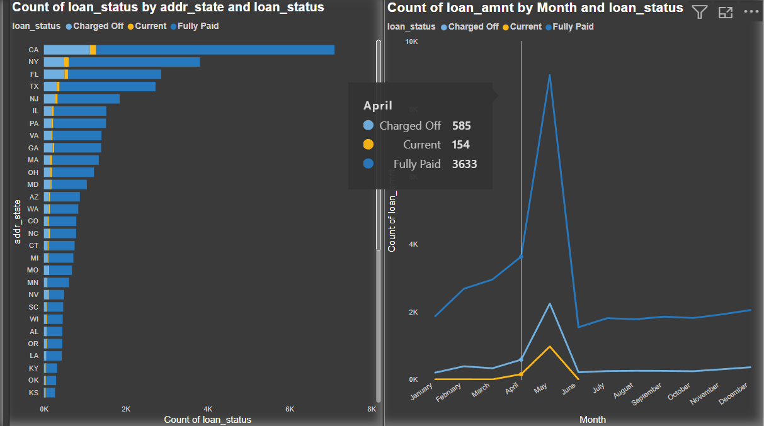

State wise and month wise loan status
.CA state has top fully paid loan status.
Current we have 154
We need to act on the charged off items.
Power Bi

Slide 10
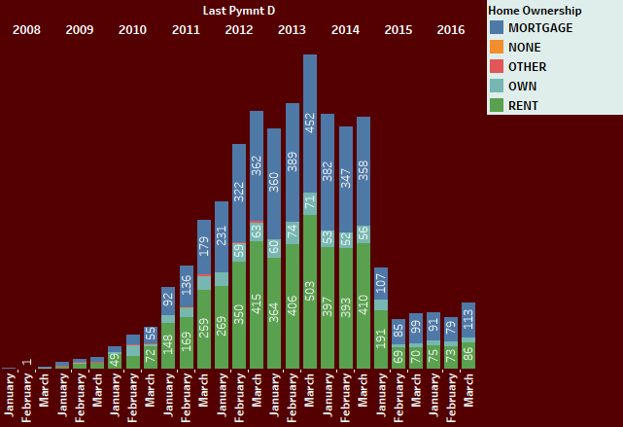

Home ownership Vs last payment date stats
We have 5 types of home ownership.
Mortgage is having highest loan amount compared to all.
Other have very low.
Every year we have rent item also.
Tableau

Slide 11
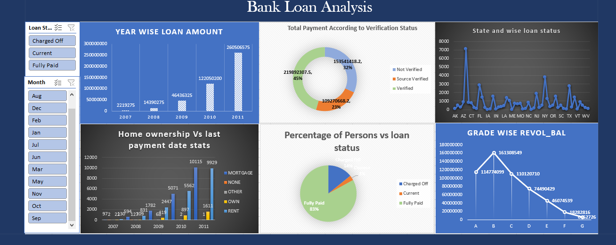

Slide 12
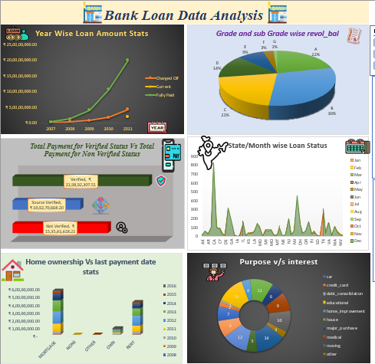

Slide 13
###Year wise loan amount Stats ###
SELECT MID(issue_d,7,4) as yearwise ,sum(loan_amnt) from financeGROUP by MID(issue_d,7,4)having sum(loan_amnt)order by MID(issue_d,7,4),sum(loan_amnt);select year(issue_d) as year, sum(loan_amnt) as totalamount from finance group by year(issue_d) order by (year);
###Grade and sub grade wise revol_bal###
SELECT grade,sub_grade,sum(revol_bal) from financegroup by grade,sub_grade having sum(revol_bal)order by grade;
###Total Payment for Verified Status Vs Total Payment for Non Verified Status###
select verification_status, sum(total_pymnt) from finance group by verification_status having sum(total_pymnt) order by verification_status;
###State wise and month wise loan status##
select addr_state,month(issue_d),count(verification_status) from finance group by addr_state,month(issue_d) having count(verification_status) order by addr_state;SELECT (addr_state)as statewise, MID(issue_d,4,2) as Monthwise,loan_status from financegroup by (addr_state) ,MID(issue_d,4,2), loan_statusorder by (addr_state) ;
##Home ownership Vs last payment date stats##
select home_ownership, last_pymnt_d from finance order by home_ownership asc;

Slide 14
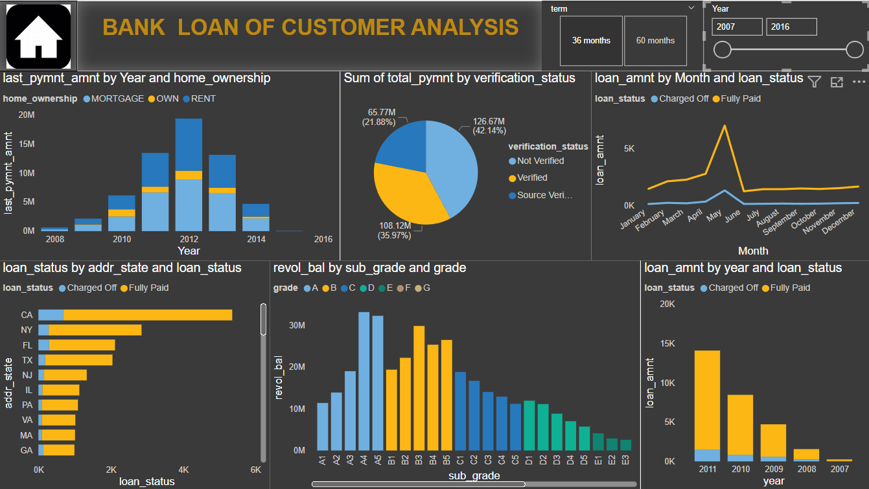

Slide 15
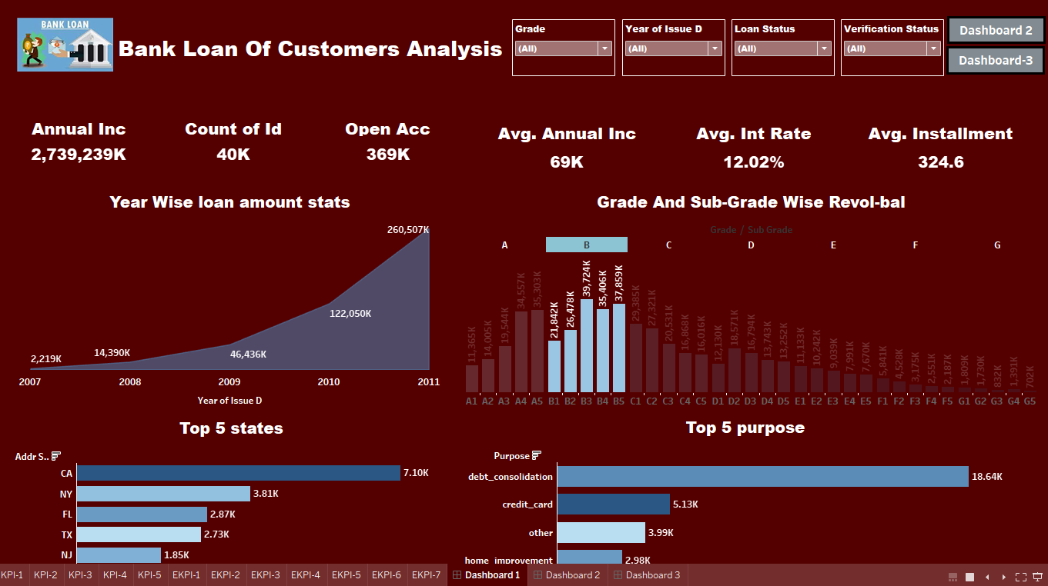

Slide 16
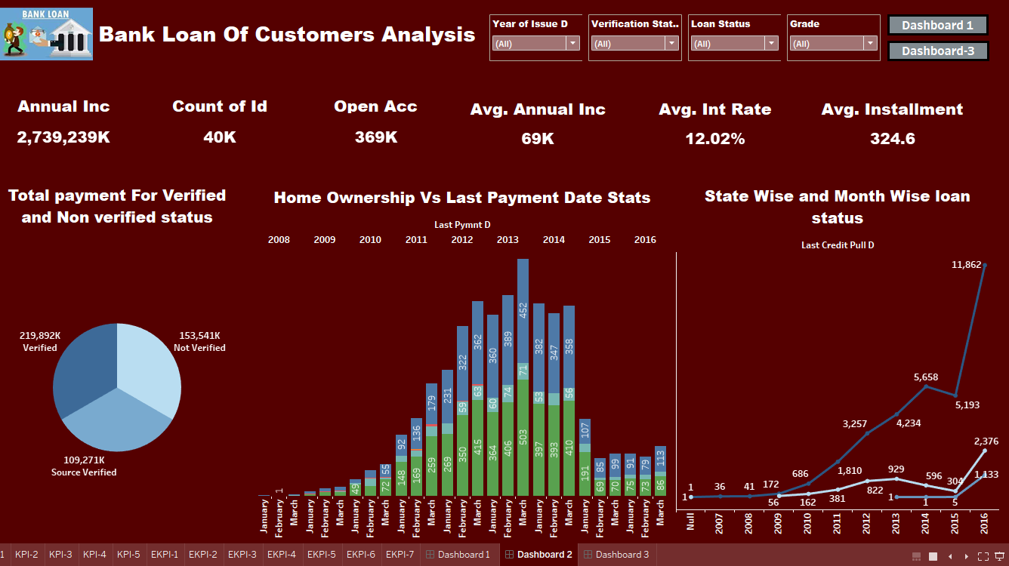

Slide 17
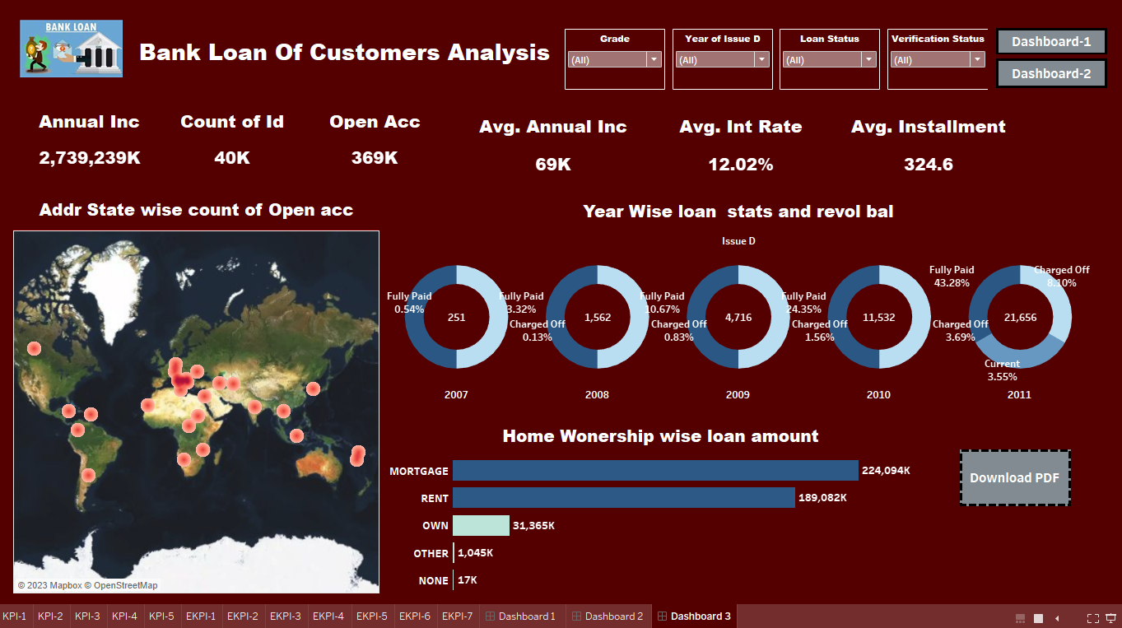

Slide 18

Conclusion:
Increasing loan amounts indicate a growing demand for credit.
The rising loan amounts reflect an increased willingness among borrowers to seek financing for various purposes.
Subgrade B3 within Grade B holds the highest revolving balance of 39.7 million.
There is a significant disparity in revolving balances across different grades and subgrades.
The source verified status contributes 109 million to the overall verified payment amount, indicating a substantial portion of the verified transactions.
The data highlights the importance of verification in facilitating higher payment volumes and potentially enhancing trust and security in financial transactions.
The sum of loan amount for 36 months is higher than for 60 months, indicating a preference for shorter loan terms.
Charged Off follows with a substantial count of loan amount, suggesting a notable number of loans have been declared as losses.
Understanding the last payment date helps in assessing the timeliness of payments and potential trends in repayment patterns for each home ownership category.
The data highlights the significance of mortgage loans in the housing market, given their higher loan amounts compared to other home ownership categories.

Slide 19



